Slide 1


High(er) Security Firefox Accounts
Sai Prashanth Chandramouli
Cloud Services Team
irc: saipc
Github: TDA
E-mail: thatsenough@youstalker.com

Slide 2
Disclaimer
All details on these slides are purely fictitious based on fact.
No Animals were harmed in the making of this slideshow (unless you count me).
I make obscure references to filmography and some computer fields. Ask if it is unclear.
All photos/images used here were taken from(sometimes of) free-to-get sources like xkcd, and my team mates ( jgruen and pdehaan). Any copyright infringement claim will fall flat on its face, so don’t even think about it.
Any references, messages, images bearing resemblance to any real life object, person or animal were probably NOT coincidental, and any that are found to be offensive were probably meant to be offensive.
So quit whining and let’s move on to the next slide.

Slide 3
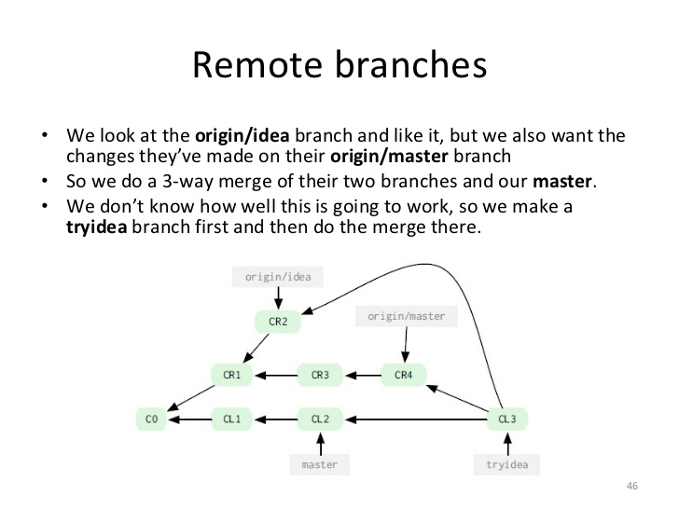
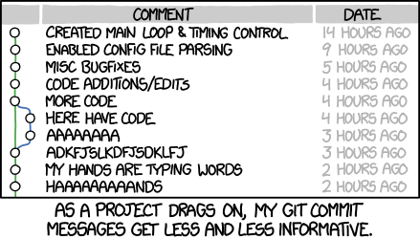
My Summer so far
First Week – Getting used to version control with Git and GitHub.

Slide 4
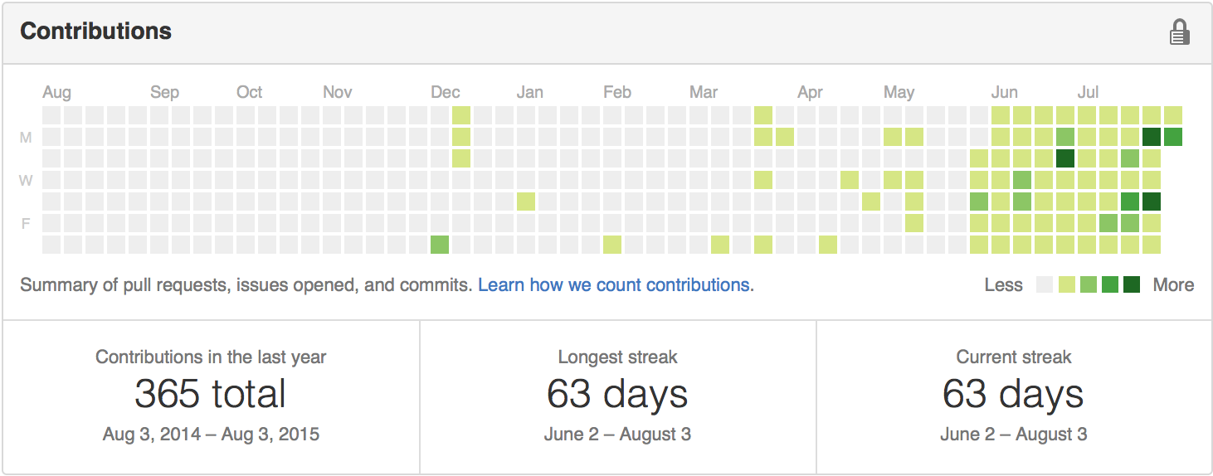
Git – The know it all
“I know what you did this summer“ - Git

Slide 5
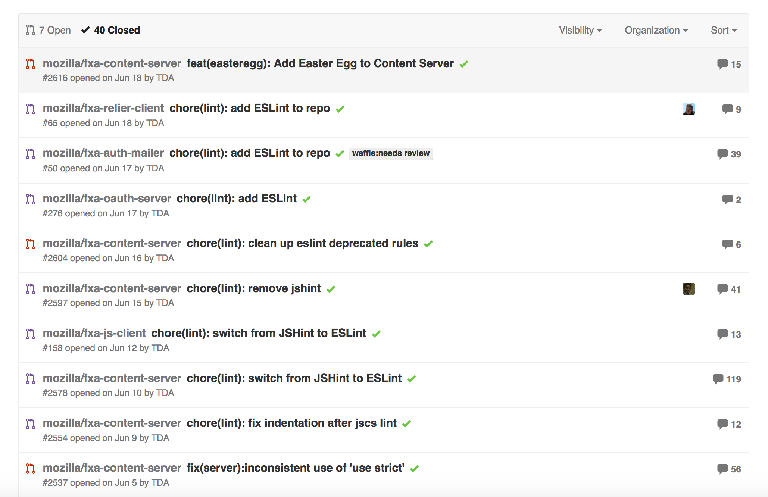
So how did my Summer go?
I worked on a bunch of bug fixes, mostly related to build stuff like Grunt and linting / linters (jshint, eslint and jscs). → See what I did there?

Slide 6
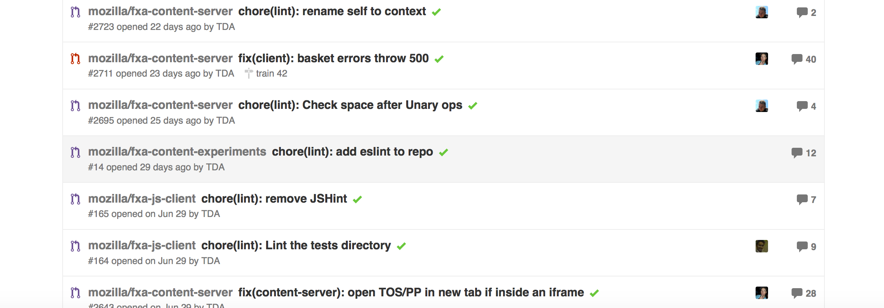
Well.. And?
I also worked on front-end bugs like Internet Explorer 8/9 compatibility stuff. – Yeah, real cool, I know. Don’t be jealous.
And some iframe stuff, basket errors and more linting.
We need MOAR LINTING!!!

Slide 7
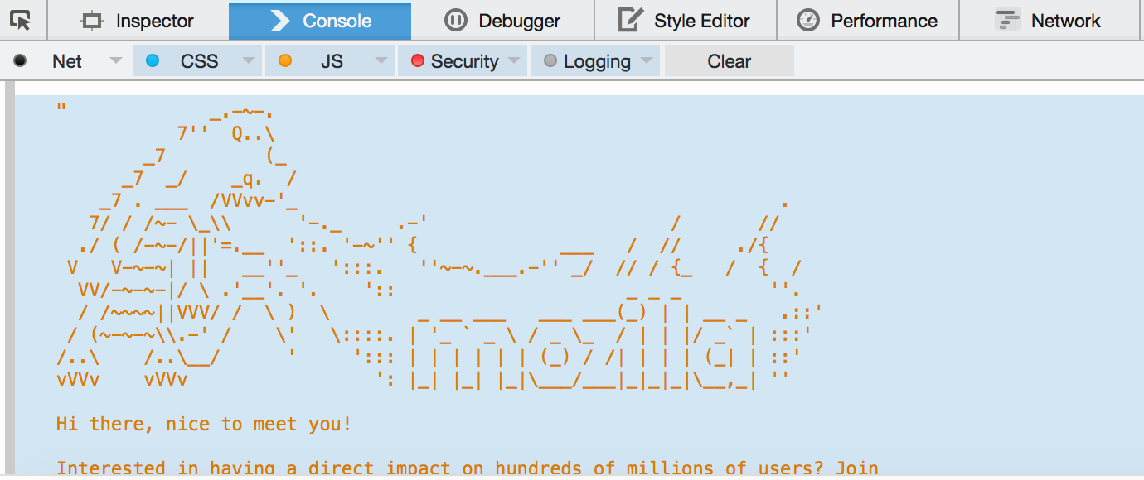
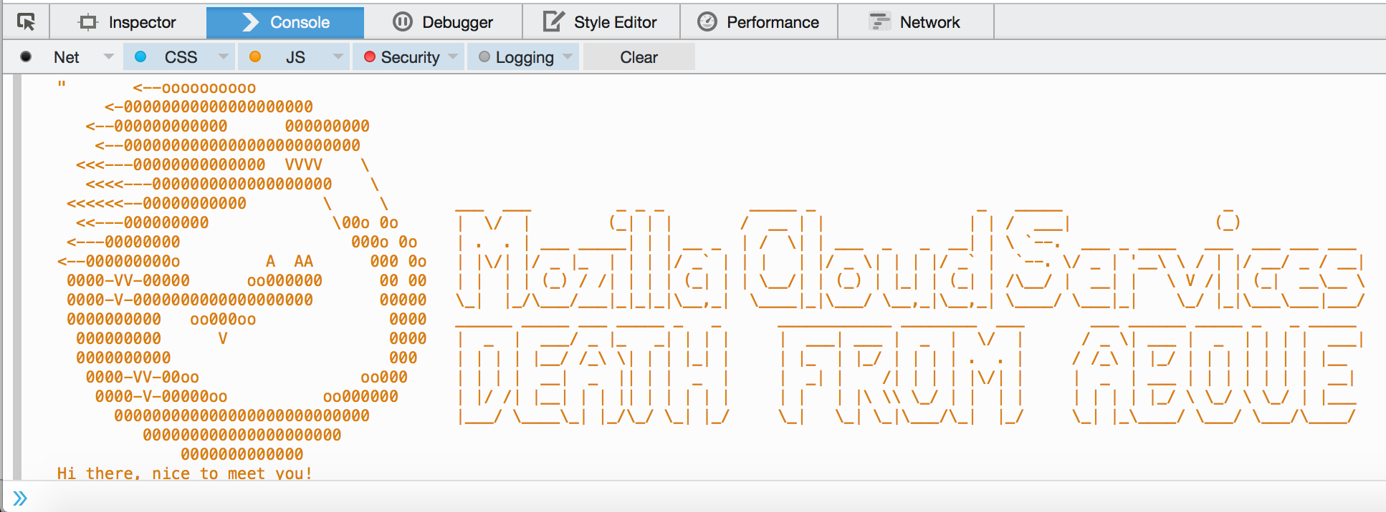
WELL??!?!?!?
Ok, I also added a sweet looking easter egg to the console in the Firefox Accounts page. (Could have been the one on right, if not for that pesky reviewman.)
Pic Courtesy : jgruen

Slide 8
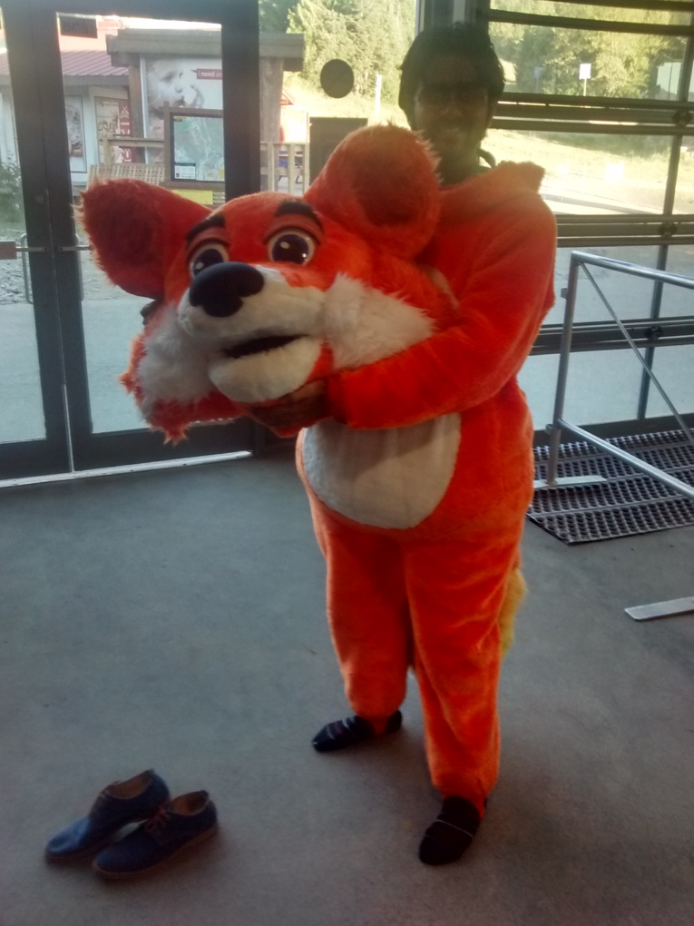
Really? THAT was all you did this summer?
You mean cool stuff? Like this?:

Slide 9
O.K. Calm down.
But all jokes aside, I worked on 3 really nice projects this Summer:
Two-Factor Authentication system for Firefox Accounts
A Password Strength Checker for Firefox Accounts
A tool to check for and remove malicious code from FxA content-server pages, and l10n translations.
Politically correct much, rfkelly? ;)

Slide 10
FxA - Password Strength Checker
Motivation:
People usually use easy-to-remember passwords, and this results in easy cracking.
Passwords get stolen, accounts get hacked due to weak passwords, etc.
Goal:
Make a suggestion to the user to use a better password, that is not easily bruteforced.
Log metrics to find if such a tool is really required.

Slide 11
The Pledge
Detect short passwords, remember, the shorter the password, the easier to brute force.
Detect whether the user’s password is all numbers/alphabets.
Store a list of common passwords that are known to be leaked from other popular services, and cross-verify with this list.
→ You are joking right? There could be millions of passwords that belong to this category.

Slide 12
The Turn
Right. There were 64 million passwords.
64 Mill → 5 Mill → 53,251
Database of leaked passwords and weak passwords → obtained a list of 64 mill passwords. [1]
Storing them → ~800MB.
Yeah. MB. For a client side strength checker list.
Ignore passwords that were less than 8 characters long → ~5+ Mill. → ~80MB
Combed through these with my trusted buddy Python, to separate out these into categories of ‘Regexes’.
I ended up with 2 regexes that eliminated almost 98% of these passwords. → Down to 53,251 passwords, still weighing in at a hefty ~5,500 Kilo grams Bytes.
^((?:.*[!@#$%^&*()_+]{0,1})[A-Za-z\d ]{7,11})$ ([a-zA-Z]){8,12}|([0-9]){8,12}
[1] https://crackstation.net/buy-crackstation-wordlist-password-cracking-dictionary.htm

Slide 13
The Prestige
Ha! Was waiting to use that one :P
Bloom Filters to the rescue!!!
So I ended up using a bloom filter to store the passwords, instead of storing them in Plaintext.
A bloom filter stores only a hash of the actual password, and excels in look up, with blazing fast speeds to check if a password is in the filter.
Well, kind of.
A very good write up on the subject can be found at https://www.jasondavies.com/bloomfilter/ → We used his implementation of a bloomfilter with the Fowler–Noll–Vo Hashing technique.

Slide 14
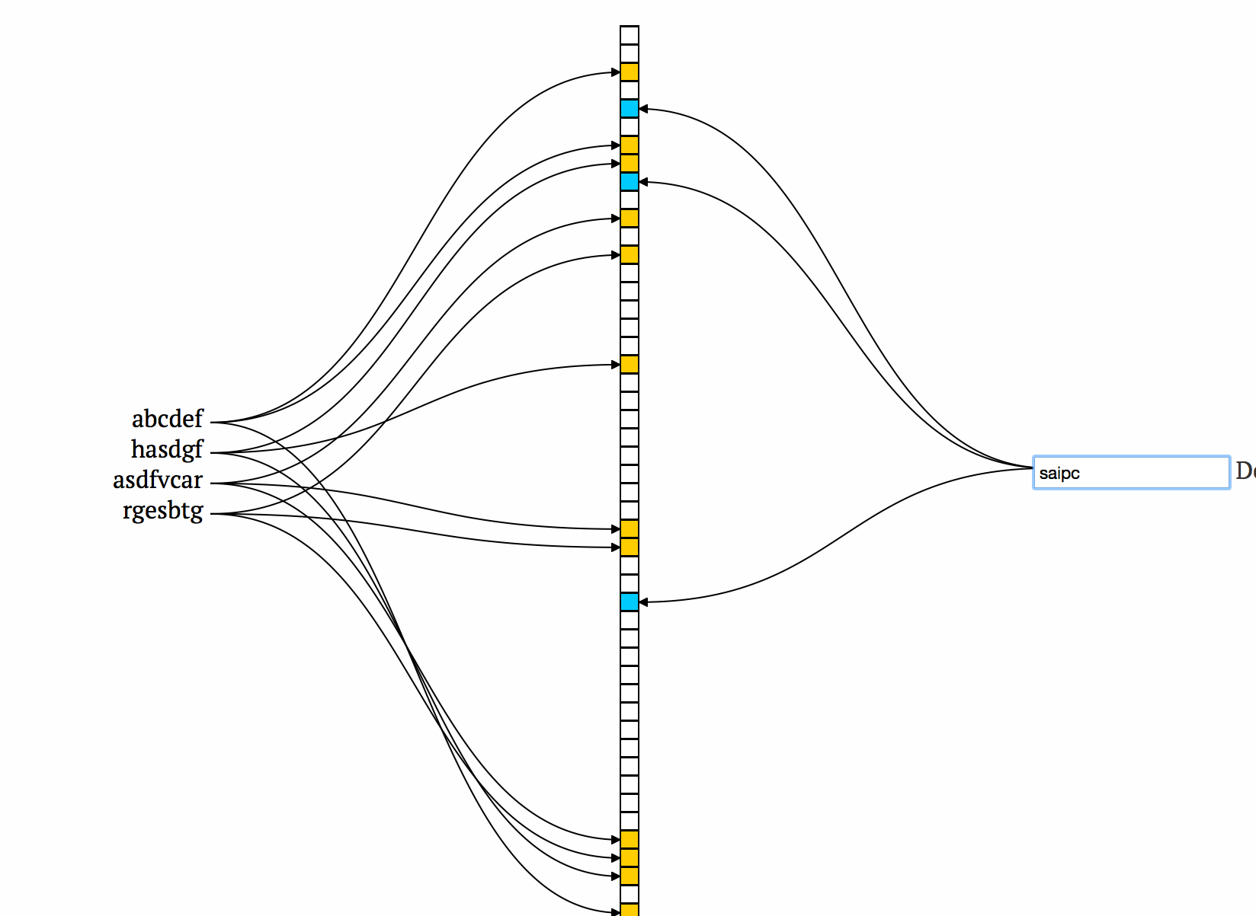
The bit vector trick

Slide 15
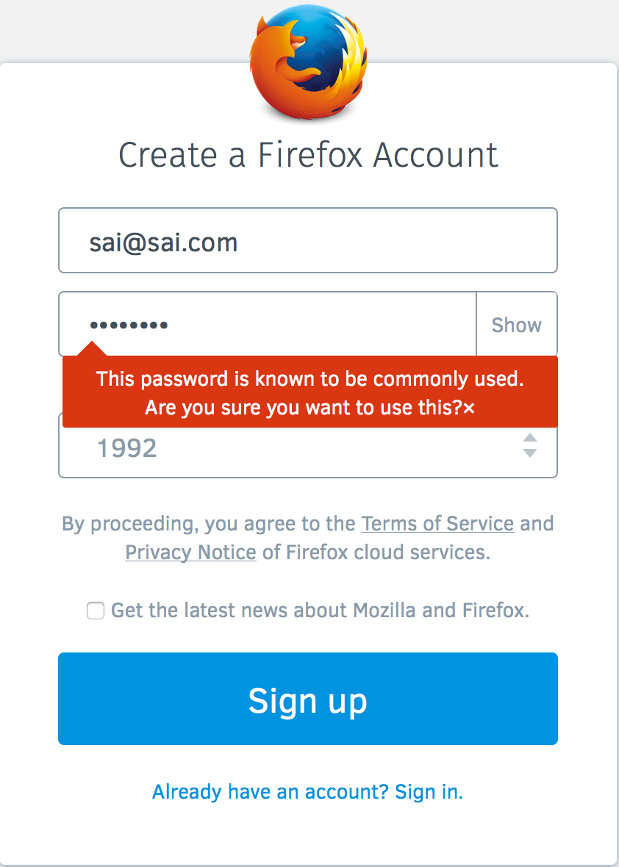
Results
The Password Strength Checker is (almost) ready to ship. It is a teeny 93 kb gzipped. We are currently only collecting metrics, but a future version can/will include a tooltip (just by varying the callback provided).
It can be found at
https://github.com/mozilla/fxa-password-strength-checker
Or if you want to play around with values:
https://github.com/TDA/bloomFilter

Slide 16
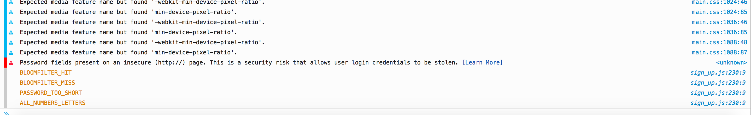
Results - Continued
Z = (experiment.pw-strength.not_strong_enough / experiment.pw-strength.engaged) * 100 IF Z is low - means we should not invest into UX to improve password strength If Z is high - we tell users their password is weak and suggest users to include a number or a letter in their password
Y = (experiment.pw-strength.bloomfilter_hit / experiment.pw-strength.engaged) * 100 IF Y is low - bloomfilter is not useful, remove it IF Y is high - bloomfilter is useful, we should make it better and use it for UX
Equations courtesy: Vladikoff

Slide 17
FxA – Tool to verify HTML/CSS
Motivation:
FxA uses a lot of html, css in l10n translations, and in emails to users.
HTML/CSS *always* provides an attack vector to be exploited. [1]
Goal:
Make sure that all HTML uses valid syntax.
Maintain and impose a whitelist on the tags and attributes allowed.
Make sure that our translators are only using valid urls and not changing the urls we provide. Aka. Whitelist urls
Make sure that the style attribute is not misused, and has valid rules.
In one umbrella term, “Make sure our pages aren’t susceptible to XSS vulnerabilities through our markup or styles.”
[1] https://www.owasp.org/index.php/XSS_Filter_Evasion_Cheat_Sheet

Slide 18
One step at a time
Make sure the HTML is valid:
Regexes – They suck. Why?
HTML Gumbo Parser – Reasonable, but reinventing the wheel. Why?
The XSS module – (Gumbo + regexes) on steroids. Terrible Idea? Not really!
Allows us to maintain a whitelist of allowed tags and attributes for those tags.
Allows us to remove/modify anything that doesn’t belong to the whitelist.
So, “Reparo!”. ( I cant really pronounce xss-us reparo)

Slide 19
Issues
XSS module doesn’t work on broken html!!
HTML-Lint to the rescue!
So, we essentially have an XOR between HTML-Lint and the XSS module.
If there is a problem with the HTML, one of them is *bound* to throw an error (at least in theory).

Slide 20
Make sure the URLS are legit:
Cause for concern: A team member joked that someone might change our URLS to something like bing.com. (Seriously, that was the most evil thing he could think of)
I wrote Grunt tasks to:
grab the server.pot file, use a po2json convertor script on that, run through the JSON key-values, and then grab the URLS.
compare the set of legit URLS to the generated/translated files, and flagged anything that wasn’t in the set of legit URLS.
(i.e) .po (portable object) and .pot (portable object template)

Slide 21
Findings:
As if to prove our concern, we found that Firefox China had its OWN implementation of the content-server, and had modified some URLS to point to their locally hosted content-server, rather than use ours.
Think for a minute. Breathe. Think again.
http://firefox.com.cn/ and http://mozilla.com.cn/moz-portal.html are modified to ‘suit’ the Chinese audience, complete with a blog, ads, and a QR Code to install WeChat. Yup, you read that right.

Slide 22
This slide was intentionally left blank (read as ‘removed’), after inputs from pdehaan and vladikoff, to prevent an international incident.
No kidding.

Slide 23
Make sure the styles are legit
I used a very similar approach to extracting the URLs (previous slide, already forgotten??), with slight modifications to extract, and check for the presence of allowed styles.
Combined with the xss module checking for whitelisted CSS attributes, this looks pretty robust.

Slide 24
And that brings us to.. *drumroll*
Two-Factor Authentication for Firefox Accounts
Motivation
Highly awaited feature.
My mentor loves this idea.
I have worked on multi-factor before, with Facial Recognition (keylemon) and Passwords.
What more do you want? Really?

Slide 25
Issues
Adding two-factor authentication to the signup flow needs lots and lots of user-testing.
And work. Lots of work. From a lot of people. From different parts of the team.
Using SMS as a second-factor needs monetary investment. A lot of investment.
Tl;dr: All these put together would result in a project that is much bigger and longer than my internship period.

Slide 26
So, we settled for:
Setting up the 2-Factor options inside the settings page.
Using Google Authenticator as the second-factor, and implementing the TOTP algorithm.
Laying out the framework/infrastructure for expanding the two-factor auth system to include other forms of authentication.
Most importantly, learning what is needed to make this project a success.

Slide 27
TOTP and Google Authenticator
We Implemented a simple version of the TOTP as outlined in the RFC 6238 [1] and RFC 4226 [2].
Essentially, we generate a unique secret key(randomly, based on seed values of current time, mouse movements etc using sjcl/cryptojs) for every user.
We then create a new One-Time-Password(OTP) every 30 seconds. This is not stored, but computed on the fly.
We generate a QR Code that can be read by the Google Auth app.
Google Auth generates the OTP for the user every 30 seconds on the users mobile device.
We compare the server generated key with the key entered by the user, and bam! Second factor ready!
[1] https://tools.ietf.org/html/rfc6238#section-4.1
[2] https://tools.ietf.org/html/rfc4226

Slide 28
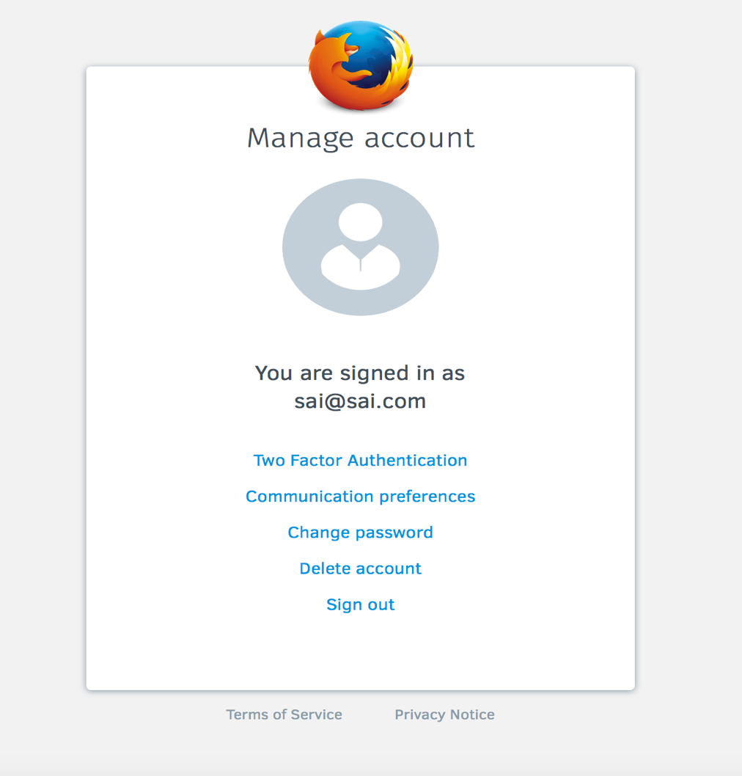
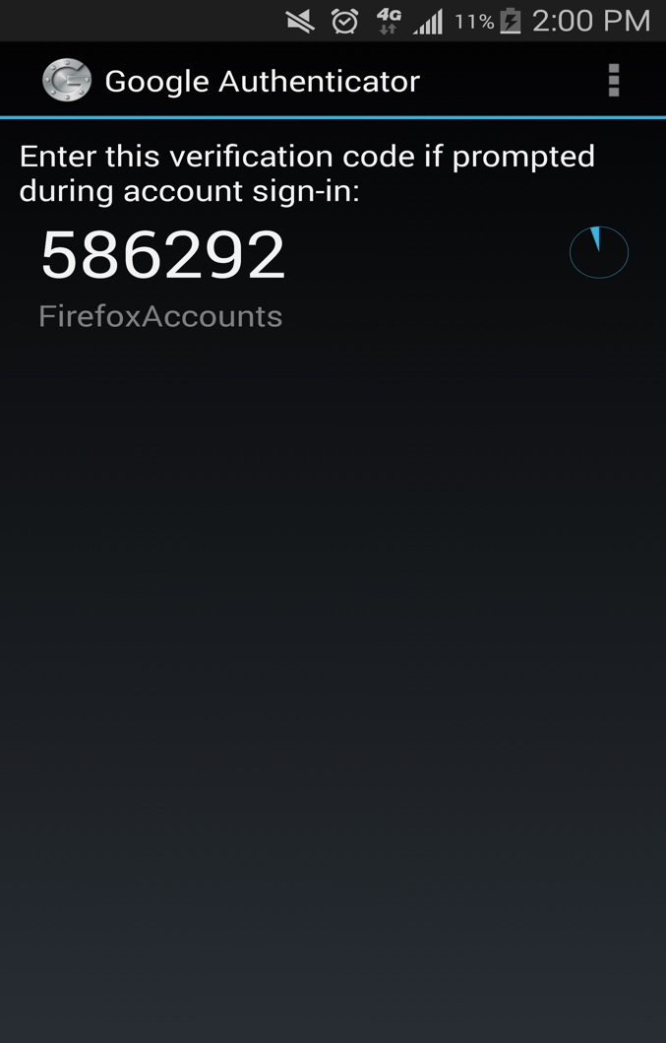
Screens for Two-Factor Authentication
Ignore the badly sized screens
Set up two factor inside the settings page
Google Auth generates the OTP for the user

Slide 29
So, how far along are we?
Pretty far. In fact, I have a working demo of setting up a 2-factor on FxA.
You can check this out at:
https://github.com/TDA/fxa-two-factor-auth - Integrated (mostly), with FxA.
https://github.com/TDA/2fa - A more customizable, stand-alone module/demo for 2fa.

Slide 30
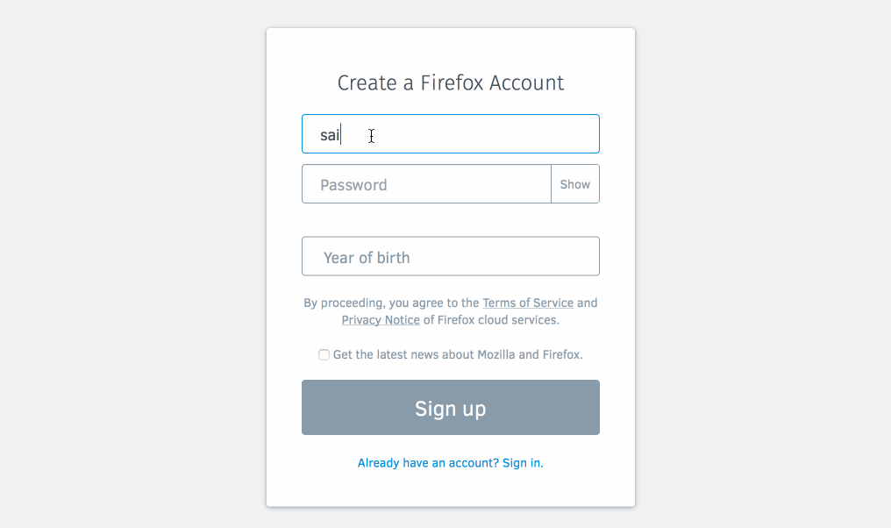
Two Factor Auth - Demo

Slide 31
Results
We learned a lot from this Project, and most of those are documented in the following document:
https://github.com/TDA/2fa/blob/master/Software%20Requirements%20Specification%20-%202FA.docx
We learnt how TOTP and Google Auth works, and in general how OTP’s can be generated, and verified.
Since our OTP generation is already in place, we have laid out the framework for adding other 2nd factors like SMS.

Slide 32
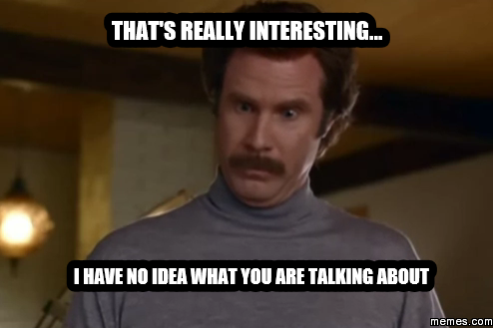
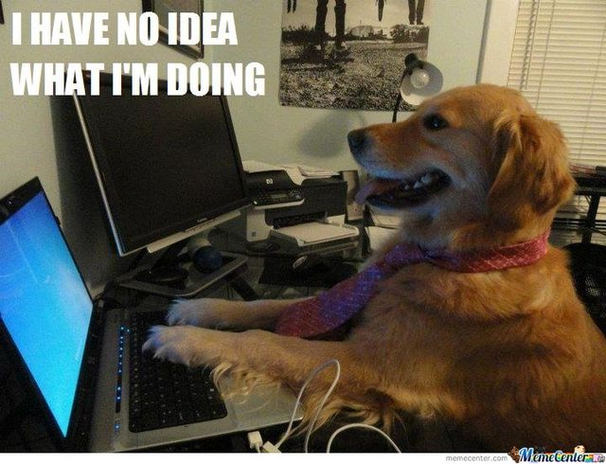

So how was my Summer you ask?
One word. Awesome.
Ranging from:
Hearing about the ideas I was going to work on and starting the work.

Slide 33
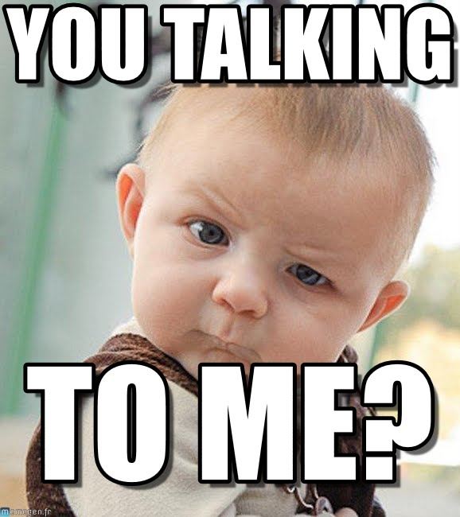

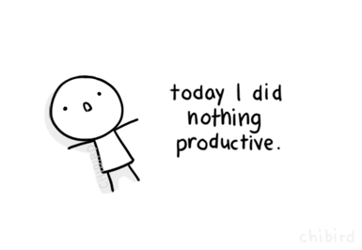
To..
Reading reviews telling me to change something.

Slide 34
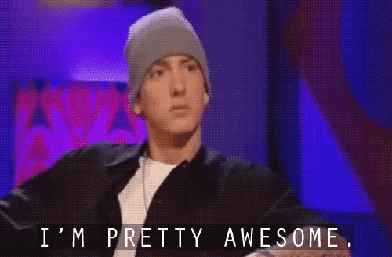
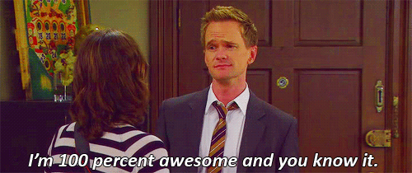
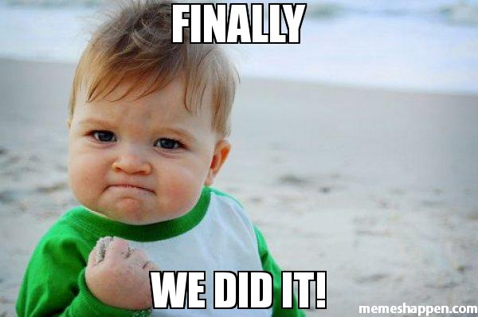
And finally to..
When I finally got a PR to land.

Slide 35
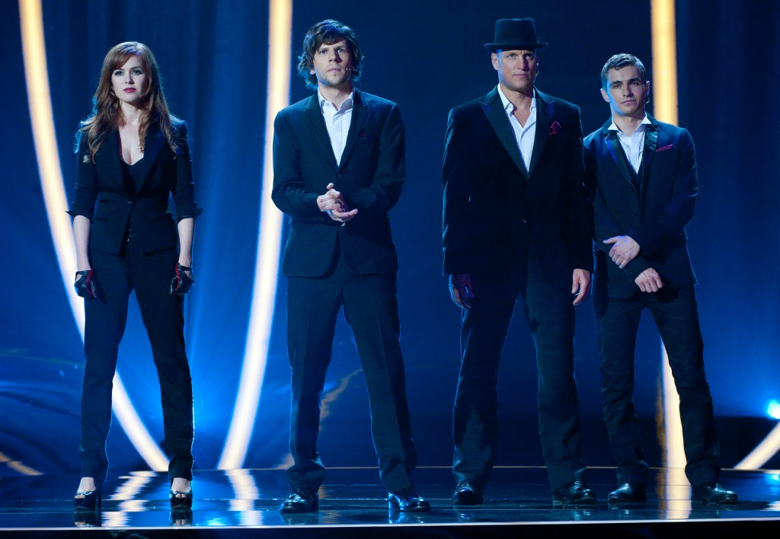
Thanks to..
The University Recruiting team – Misty, Kyle, Ivadell and Jill.
(Seriously guys, get someone with a name starting with ‘L’, then it can be IJKLM)
The Four Horsemen
If you haven’t seen this, you should.

Slide 36
Thanks to..
The Cloud Services Team:
Chris Karlof (ckarlof) – For all the projects and advice (and dinners).
Ryan Kelly (rfkelly) – For the security projects.
Edwin Wong (edwong) – For all the 2FA support and travel stuff.
John Morrison (jrgm) – For all the support and meetings.
Ryan Feeley (rfeeley) – For all the UX guidance.
John Gruen (jgruen) – For the extremely cool logos (and css help).
Daniel Coates (dcoates) – For helping me in Whistler.
Phil Booth (pb) – For that awesome accent.
Edouard Oger (eoger) – For the pre-push hook that made me commit lesser styling errors.

Slide 37
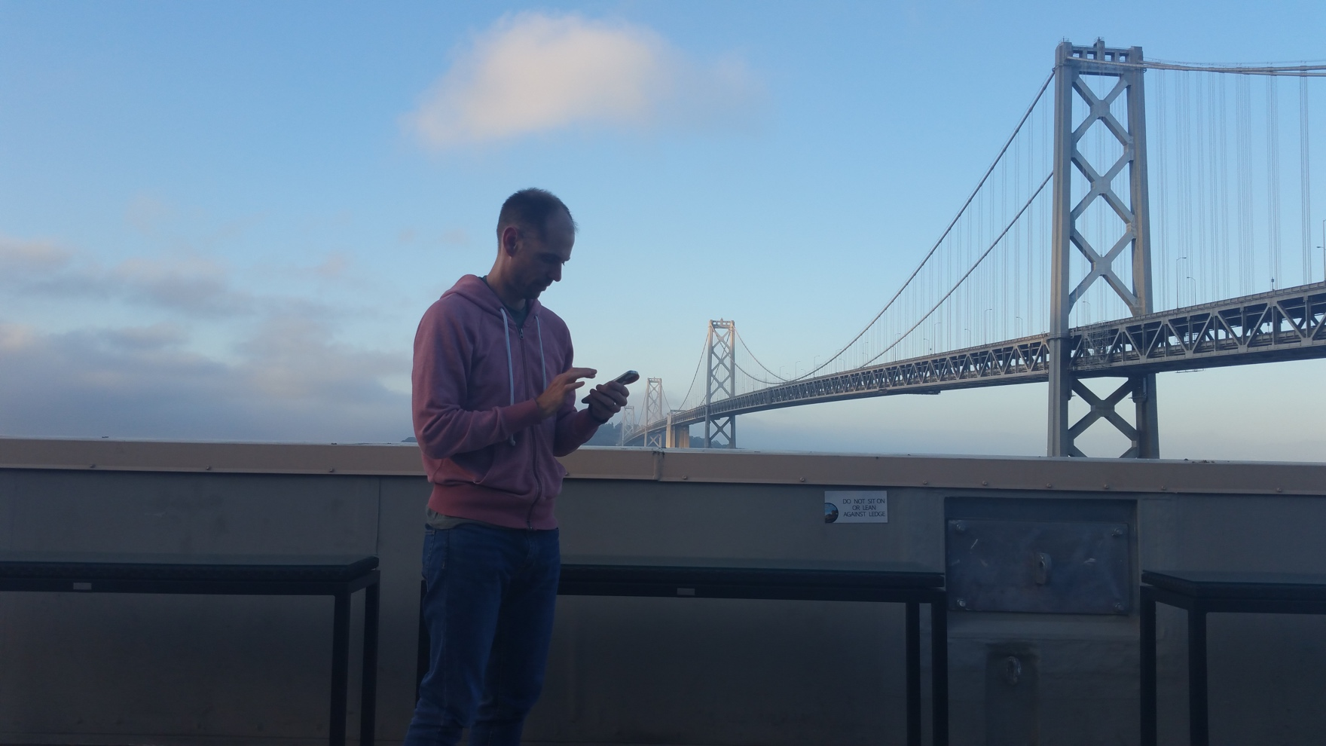
Special Thanks to..
Shane Tomlinson (stomlinson) – My Mentor and Guide
For being patient with me, and helping me out everyday, and almost everything else this summer ☺ Thanks for all the sacrifice, Shane!!!

Slide 38
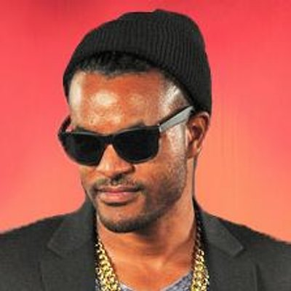
And..
Zach Carter (zaach) – My Local Mentor
Swag!
Starting from helping me set up my MacBook for development, to helping me with a dozen bugs over the next few weeks. Thank you so much Zach! ☺

Slide 39
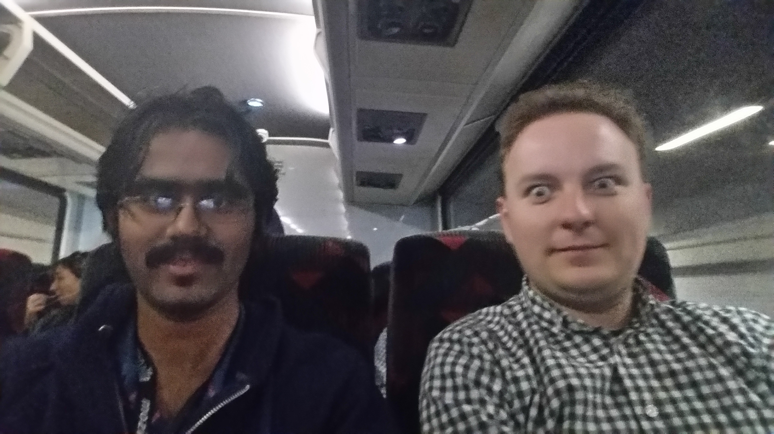
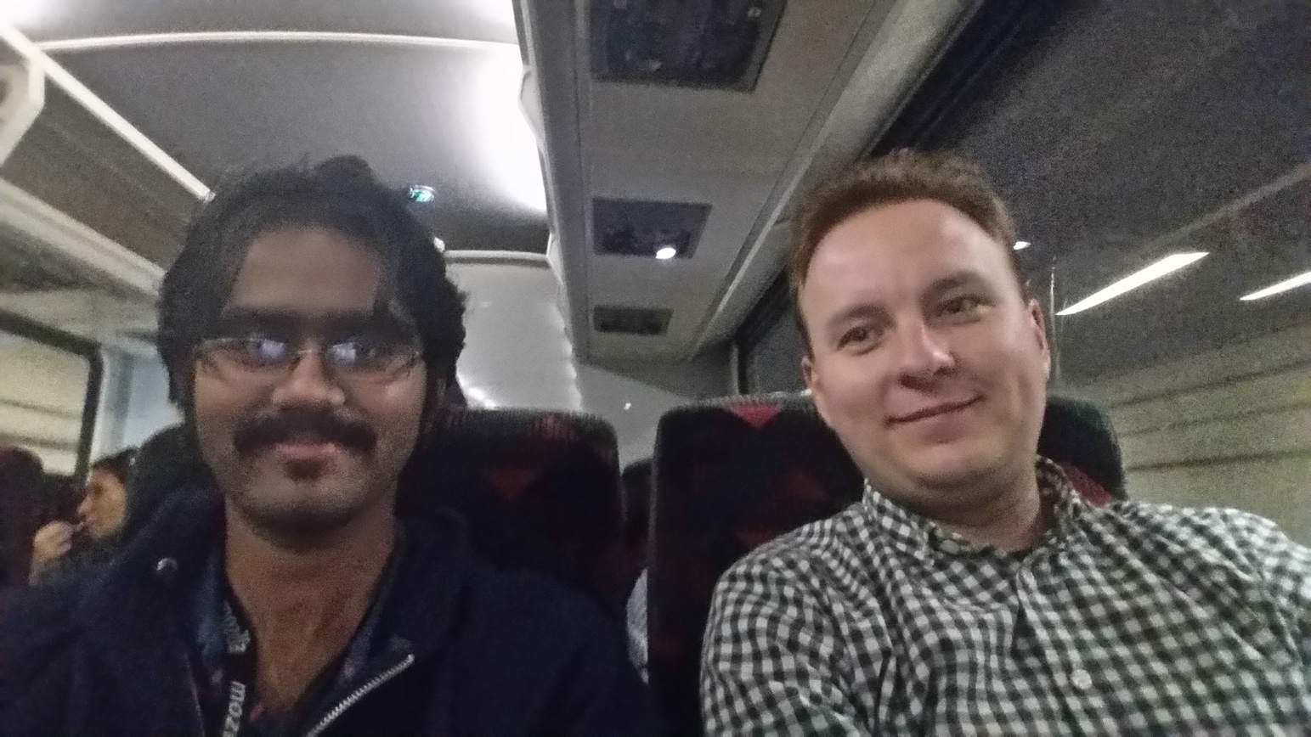
And..
Vlad Filippov (vladikoff) – The Review man.
For the countless reviews and feedback on every push ever made. Thank you so much Vlad! ☺

Slide 40

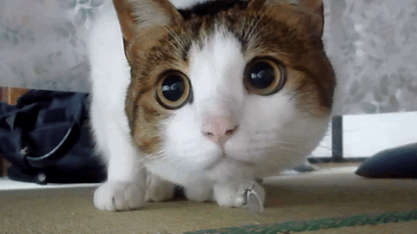
And Finallllly….
Peter Dehaan (pdehaan) – The funniest SW engineer I have met.
NOTHING EVER GETS PAST ME!!! MUHAHAHAHAHAHA!!!
Will you teach me sensei?
Peter was literally the person I ran to, every time I got stuck on ANYTHING, with the kitty face on the right. He put up with my ramblings and rants, and got me the absolute best gifs ever!! Thank you so much Peter, for finding the time to make people laugh ☺

Slide 41
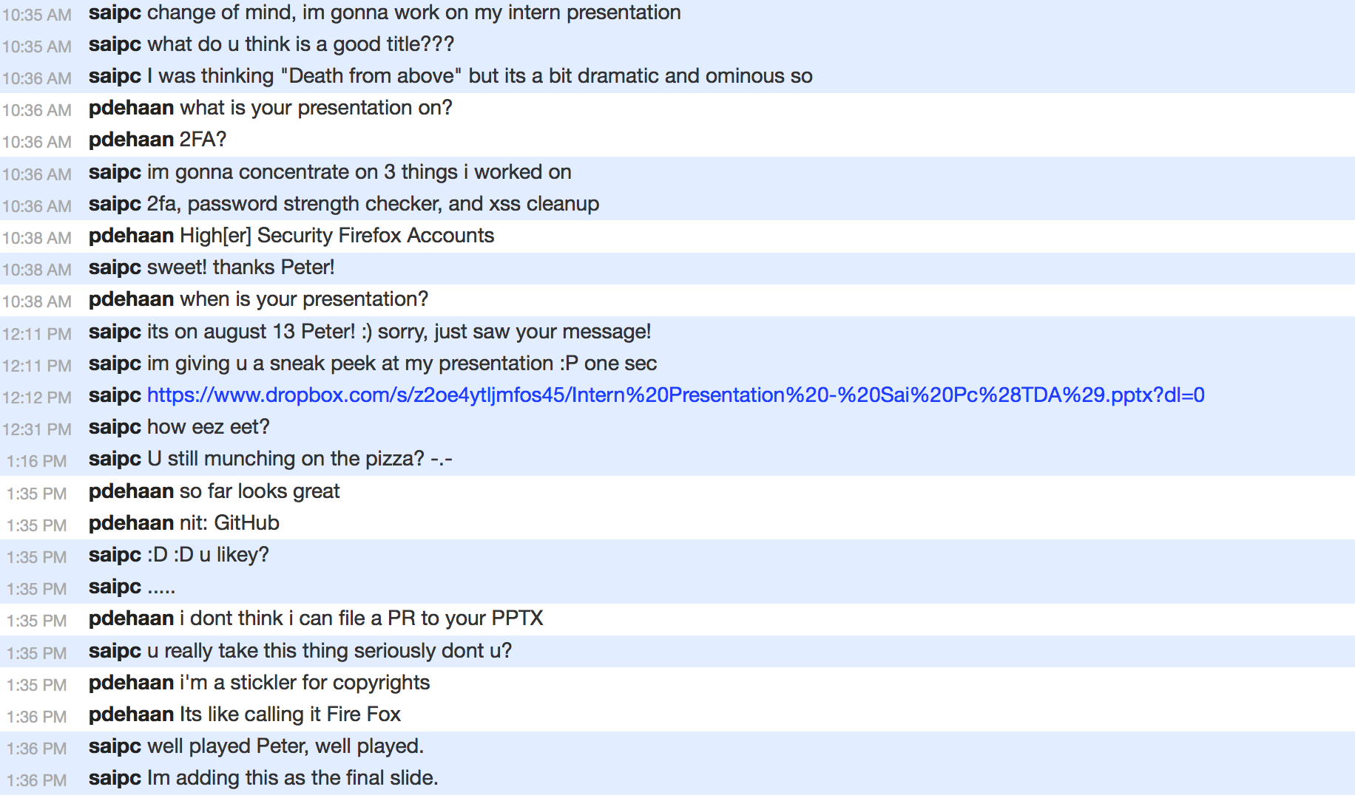
Had to add this T_T
This is why we can’t have good things in life.

Slide 42
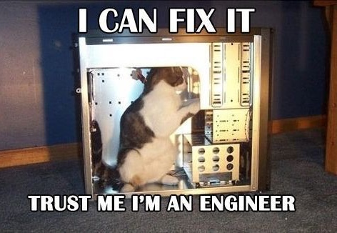
Slide 42: "Answer to The Ultimate Question of Life, the Universe, and Everything".
Questions???
The font used on the slides in general is Corbel(Body). The headings are Corbel(Headings). The slides are a default preset from MS Powerpoint.
The font used on this page is Comic Sans MS(aka most hated font of all times), just to irritate anyone who has an aversion to it. Trust me, I am a web developer.

